Slide 1
SS ZG 526: Distributed Computing
Distributed Mutual Exclusion (DME)
Chittaranjan Hota
Professor, Dept. of Computer Sc. & Information Systems
BITS, Pilani Hyderabad Campus, Hyderabad
hota@hyderabad.bits-pilani.ac.in

Slide 2

Ricart-Agrawala DME
Requesting Site:
  A requesting site Pi sends a message request(ts,i) to all sites.
Receiving Site:
  Upon reception of a request(ts,i) message, the receiving site Pj will immediately send a timestamped reply(ts,j) message if and only if:
    Pj is not requesting or executing the critical section OR
    Pj is requesting the critical section but sent a request with a higher timestamp than the timestamp of Pi
  Otherwise, Pj will defer the reply message.
Birla Institute of Technology and Science, Pilani (Deemed University)

Slide 3
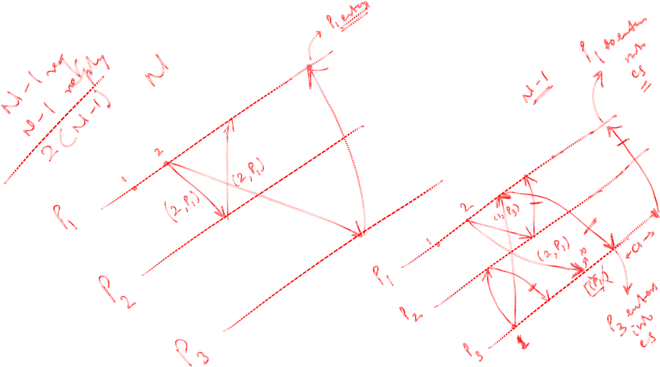
Example
Birla Institute of Technology and Science, Pilani (Deemed University)

Slide 4

Maekawa’s DME
A site requests permission only from a subset of sites.
Request set of sites S_{i} & S_{j}: Ri, Rj such that Ri and Rj will have at-least one common site (Sk). Sk mediates conflicts between Ri and Rj.
A site can send only one REPLY message at a time, i.e., a site can send a REPLY message only after receiving a
RELEASE message for the previous REPLY message.
Birla Institute of Technology and Science, Pilani (Deemed University)

Slide 5
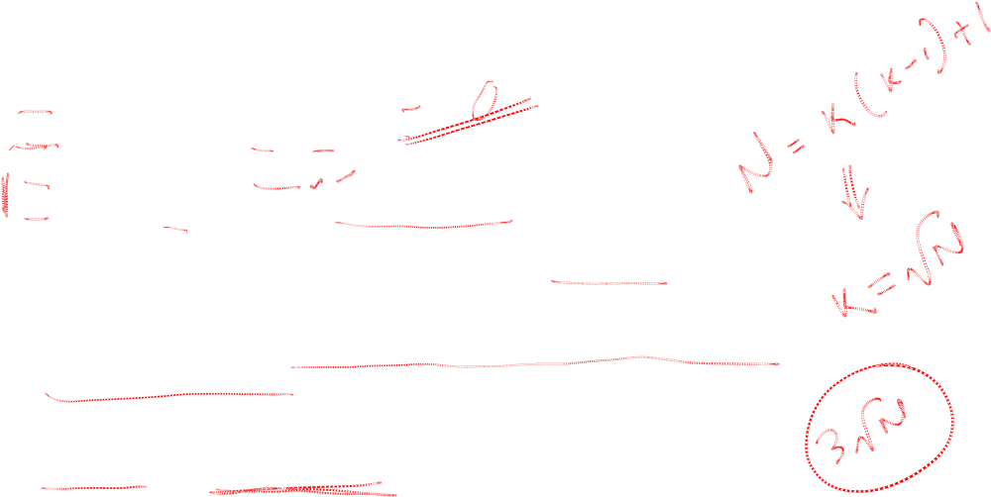
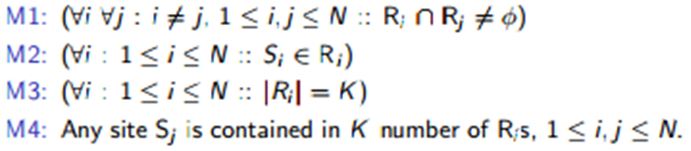
Request set
Conditions M1 and M2 are necessary for correctness; whereas conditions M3 and M4 provide other desirable features to the algorithm.
Condition M3 states that the size of the request sets of all sites must be equal implying that all sites should have to do equal amount of work to invoke mutual exclusion.
Condition M4 enforces that exactly the same number of sites should request permission from any site implying that all sites have “equal responsibility” in granting permission to other sites.
Birla Institute of Technology and Science, Pilani (Deemed University)

Slide 6
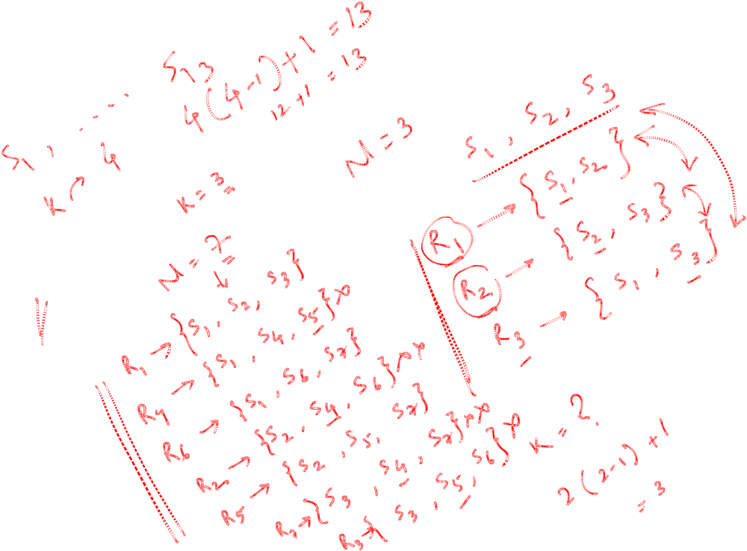
Maekawa’s Request set
R₁ = { 1, 2, 3, 4 }
R₂ = { 2, 5, 8, 11 }
R₃ = { 3, 6, 8, 13 }
R₄ = { 4, 6, 10, 11 }
R₅ = { 1, 5, 6, 7 }
R₆ = { 2, 6, 9, 12 }
R₇ = { 2, 7, 10, 13 }
R₈ = { 1, 8, 9, 10 }
R₉ = { 3, 7, 9, 11 }
R₁₀ = { 3, 5, 10, 12 }
R₁₁ = { 1, 11, 12, 13 }
R₁₂ = { 4, 7, 8, 12 }
R₁₃ = { 4, 5, 9, 13 }
N=13
Birla Institute of Technology and Science, Pilani (Deemed University)

Slide 7
Next Session
Maekawa’s DME algorithm
Birla Institute of Technology and Science, Pilani (Deemed University)

